Slide 1


Investigating the Influence of Early-Life Chemical Exposures on Health and Disease
Logan Germain, PhD Candidate
Supervisor: Dr. Louise Winn
Department of Biomedical and Molecular Sciences
Notes:
Today Im going to be discussing one of the main research interests of the Winn Lab, which is Investigating the Influence of Early-Life Chemical Exposures on Health and Disease

Slide 2

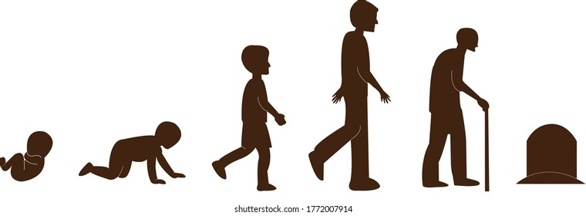

The Big Picture
How do early-life exposures to chemicals can influence later in life health and disease?
Notes:
Particularily, we are interested how early-life chemical exposures to chemicals can influence later in life health and disease.

Slide 3

The Big Picture
Why?
Embryonic development is a window of susceptibility to environmental exposures.
Notes:
Why are eartly life exposures of interest to us?
Well, Embryonic development is in something called a window of susceptibility to environmental exposures, meaning it is a period of vulnerability and sensitivity to external conditions.

Slide 4
The Big Picture
Why?
Embryonic development is a window of susceptibility to environmental exposures.
Growth and development is a highly regulated process, disruptions can have profound influences on health.
Notes:
This is because proper growth and development is a highly regulated, and complex process, where disruptions can have profound influences on health.

Slide 5
The Big Picture
Why?
Embryonic development is a window of susceptibility to environmental exposures.
Growth and development is a highly regulated process, disruptions can have profound influences on health.
Human and environmental health are intricately linked!
Notes:
As well as provides an explanation for how human and environmental health are intricately linked!

Slide 6
Developmental Origins of Health and Disease (DOHaD) Hypothesis:
A widely researched and increasingly accepted hypothesis that links environmental conditions of early life to health and disease risk later in life.
Many different mechanisms…
Notes:
Now, this is all based on something called the DOHaD hypothesis, which is a widely researched and increasingly accepted hypothesis that early life environment is a critical determinant for later in life health and disease risk.
Now there are many mechanisms by which early life exposures, conditions or experiences can influence later in life health, however the one I am mainly interested in is called epigenetics.

Slide 7
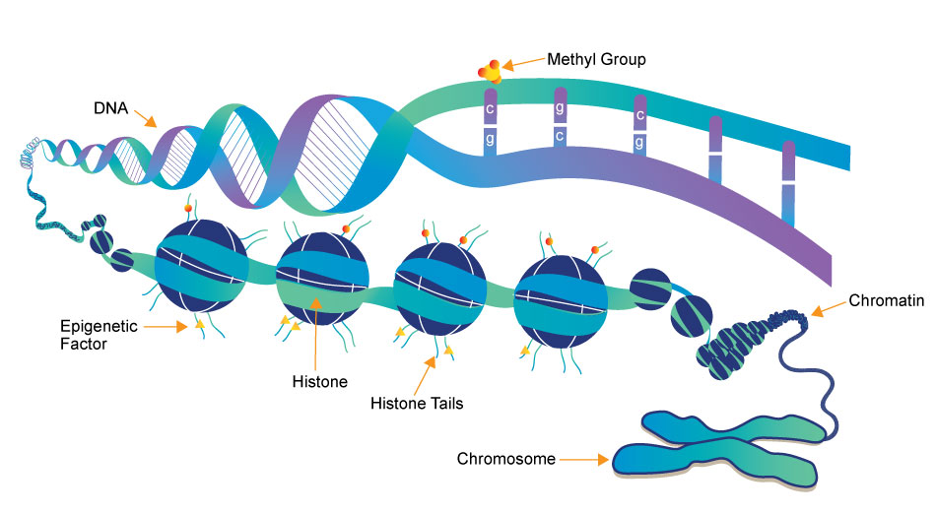

Epigenetics
Influences gene expression (amongst many other roles) without changing the DNA sequence via chemical modifications to DNA structure.
If our DNA was a book, epigenetics would be instructions to our body about how to read the book throughout out lives.
Notes:
Epigenetics: Influences gene expression (amongst many other roles), without changing the DNA sequence via chemical modifications to DNA structure.
See, If our DNA was a book, epigenetics would be instructions to our body about how to read the book throughout out lives.
https://www.cambridge.org/core/journals/journal-of-developmental-origins-of-health-and-disease/article/epigenetics-and-dohad-from-basics-to-birth-and-beyond/B6254F48E610E982C6A9727DD58EBE30
https://www.whatisepigenetics.com/fundamentals/

Slide 8
Epigenetics
Influences gene expression (amongst many other roles) without changing the DNA sequence via chemical modifications to DNA structure.
Epigenetic modifications include DNA methylation, histone modifications and non-coding RNAs.
Notes:
Epigenetic modifications include DNA methylation, histone modifications and non-coding RNAs, which all interact in an insanely complex way to regulate the expression of our genes throughout our lives, including the genes involved with growth, metabolism, DNA repair, immune system, and hormones – all important pathways for health and disease.
https://www.cambridge.org/core/journals/journal-of-developmental-origins-of-health-and-disease/article/epigenetics-and-dohad-from-basics-to-birth-and-beyond/B6254F48E610E982C6A9727DD58EBE30
https://www.whatisepigenetics.com/fundamentals/

Slide 9

Epigenetics, Chemical Exposures and Disease
Epigenetic dysregulation has been linked to various diseases, including cancer, neurological disorders, cardiovascular disease, and metabolic diseases.
Example: If an environmental factor during embryonic development causes changes to DNA methylation, this can silence tumour suppressor genes or activate oncogenes, which could predispose someone to developing cancer.
Notes:
So you can see why, if an environmental factor during the window of susceptibility of embryonic development dysregulates our epigenetics - how this might result in disease.
Epigenetic dysregulation has been linked to various diseases, including cancer, cardiovascular disease, and metabolic diseases.
Example: If an environmental factor during embryonic development causes changes to DNA methylation, this can silence tumour suppressor genes or activate oncogenes, which could predispose someone to developing cancer.
https://www.cambridge.org/core/journals/journal-of-developmental-origins-of-health-and-disease/article/epigenetics-and-dohad-from-basics-to-birth-and-beyond/B6254F48E610E982C6A9727DD58EBE30
https://www.whatisepigenetics.com/fundamentals/

Slide 10
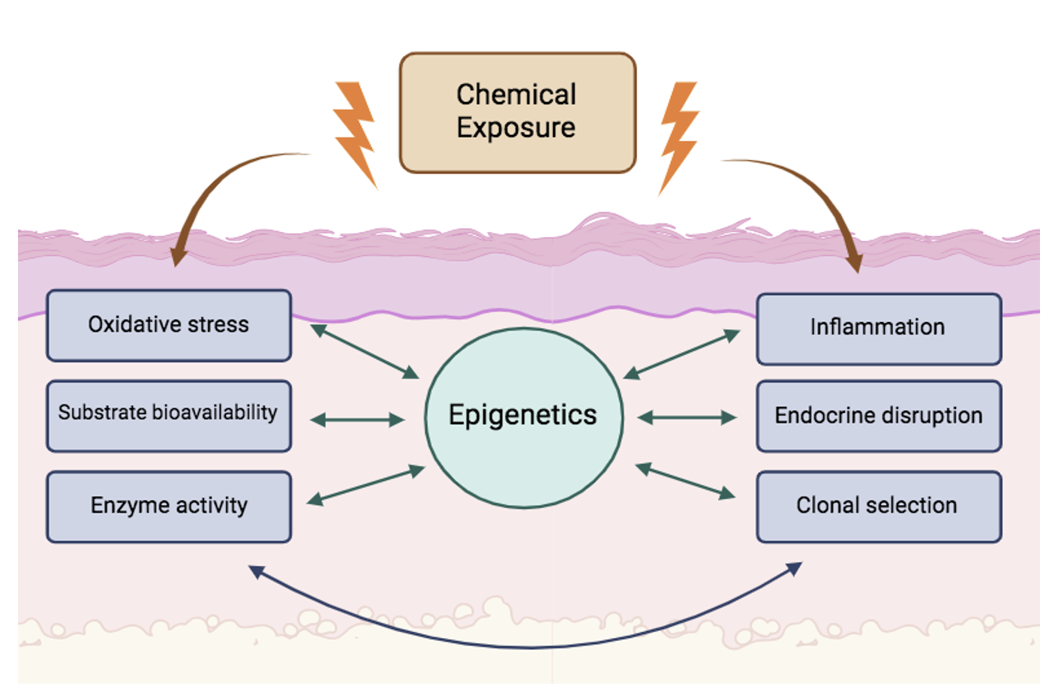
Chemical Exposures and Epigenetics
Notes:
Now you might be wondering, sure embryonic development is a sensitive time for organisms, but how exactly would a chemical or environmental exposure change our epigenetics?
Well there are so many different pathways in our body that are involved with epigenetic regulation, but some main ways that are known to play a role in how our epigenetics is programmed are:

Slide 11
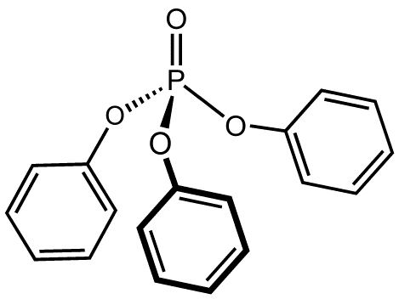








Triphenyl Phosphate (TPhP):
TPhP is an organophosphate flame retardant and plasticizer used in a variety of consumer and industrial products to meet flammability standards.
Paints
Food packaging and plastics
Cosmetics
Electronics
Lubricants
(van der Veen & de Boer, 2012)
Notes:
Now all of this brings me to a particular chemical of interest.
TPhP = Triphenyl Phosphate
A chemical used in plastics, furniture, flame retardants
Found in household dust, air, and consumer products
Why I study it:
It’s an endocrine-disrupting chemical — can mess with hormone systems
We don’t fully understand how it affects early development

Slide 12
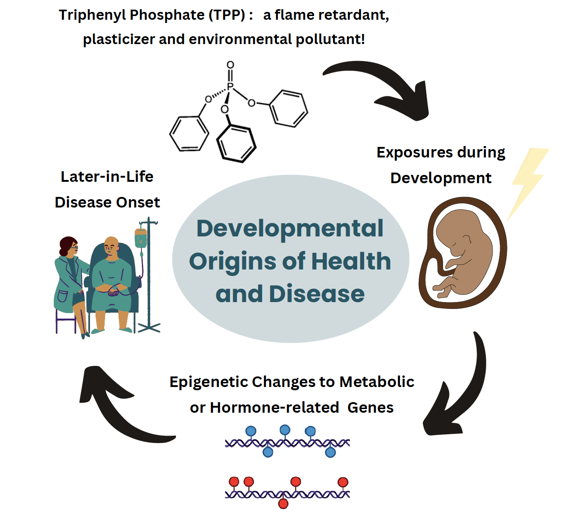
Notes:
My research question: Does embryonic TPhP exposure change gene regulation and health outcomes through epigenetics?
I look at how exposure to an everyday chemical during early development may change these epigenetic marks and possibly affect metabolism, hormones, or disease risk later in life.

Slide 13
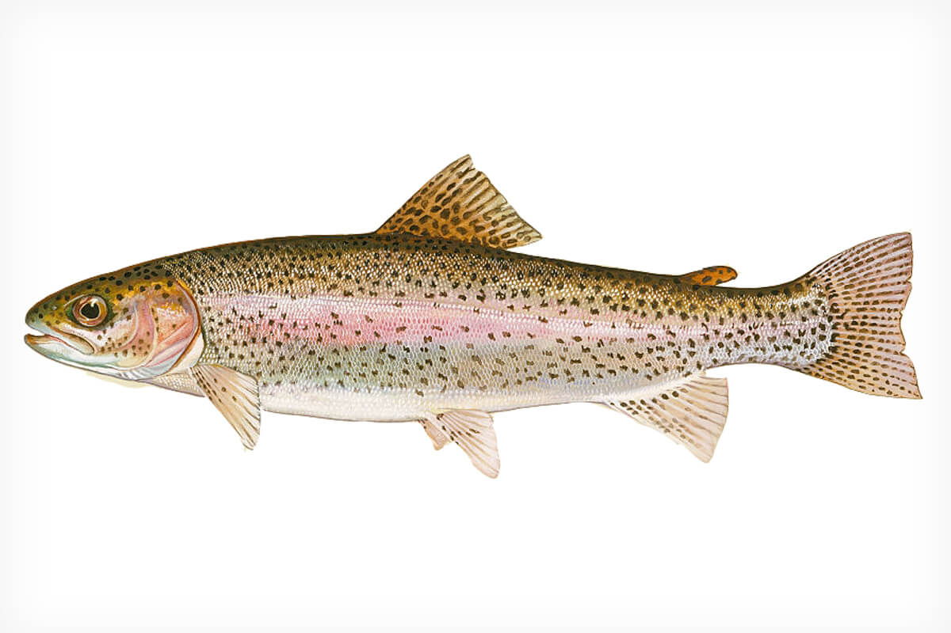
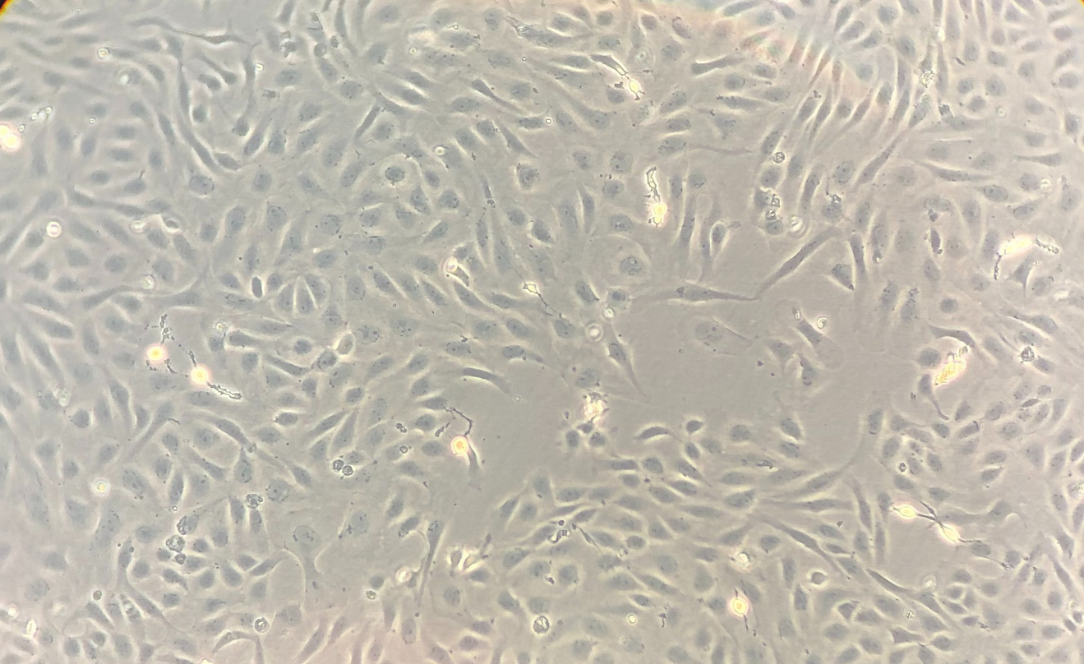

In vitro model of embryonic development
STE-137: immortal cell line derived from embryonic tissue
*Derived from rainbow trout (Oncorhynchus mykiss)
Notes:
This study is being conducted in two immortalized cells lines derived from trout. RTGill-W1 is derived from the gill epithelial tissue and represents a population of somatic cells, which STE-137 is derived from pooled embryonic tissue and represents a population of germline cells.
Trout, and specifically rainbow trout along with zebrafish are increasingly being used as a model for ecotoxicology and to study human genetics, as many genetic mechanisms remain the same between species.

Slide 14
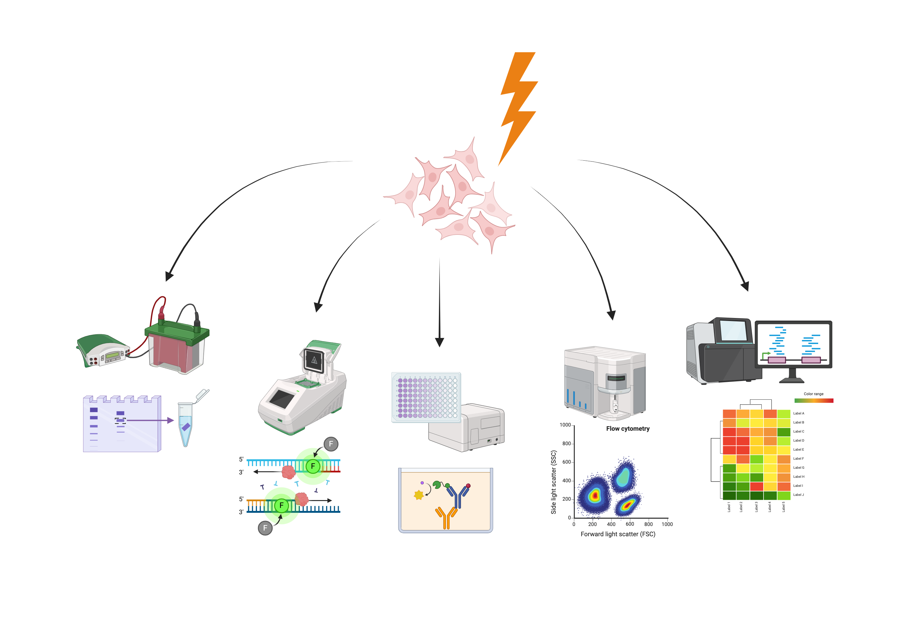
How do I study this?
Expose embryonic cells to TPhP
1. Western Blot
5. Sequencing
2. RT-qPCR
4. Flow Cytometry
3. ELISA assay
Notes:
Each technique gives me a different piece of the puzzle. I’m basically trying to connect the dots between chemical exposure → epigenetic changes → gene expression → possible health effects.
If you w

Slide 15
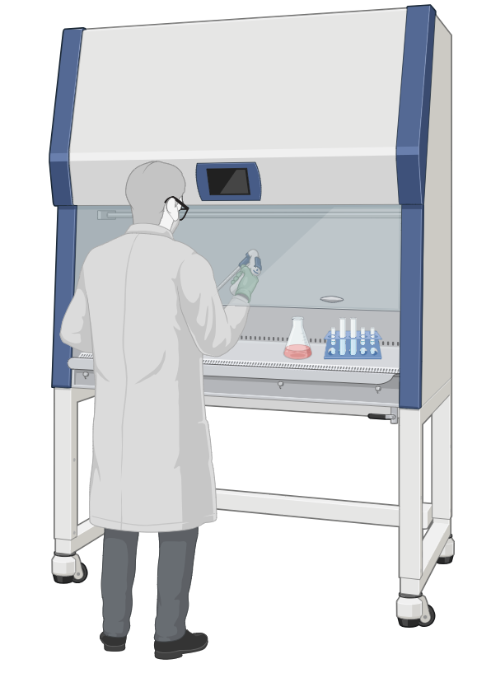
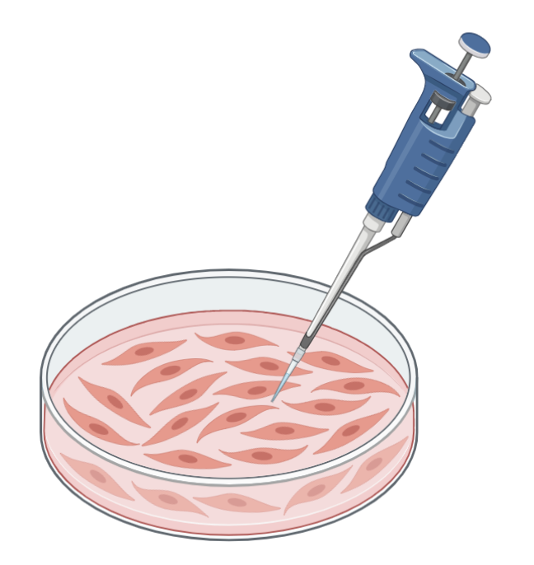
Techniques that I’ve learned!
Cell Culturing: I maintain a cell line derived from rainbow trout embryonic tissue.
This involves “feeding” the cells every 3 days, splitting the populations in half when they grow and then exposing and harvesting them for use in experiments.

Slide 16
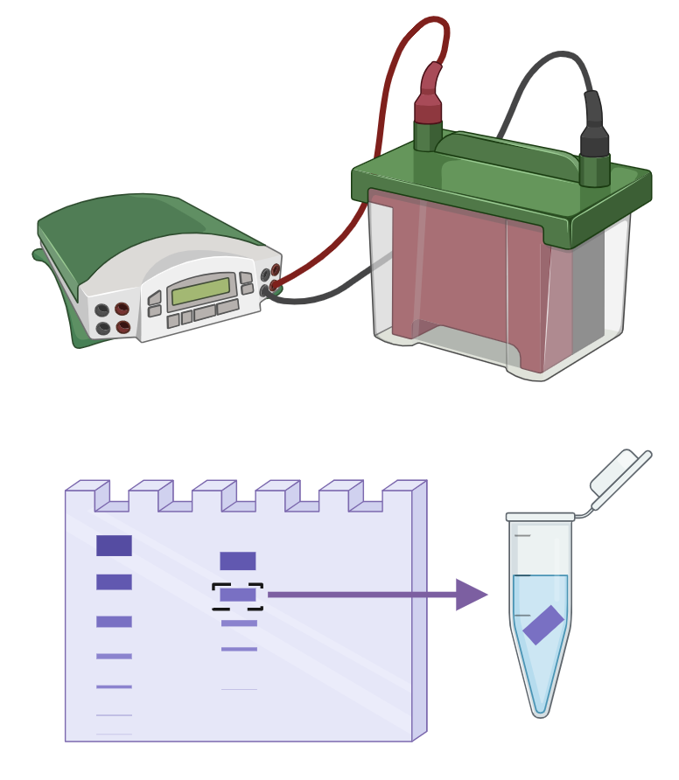
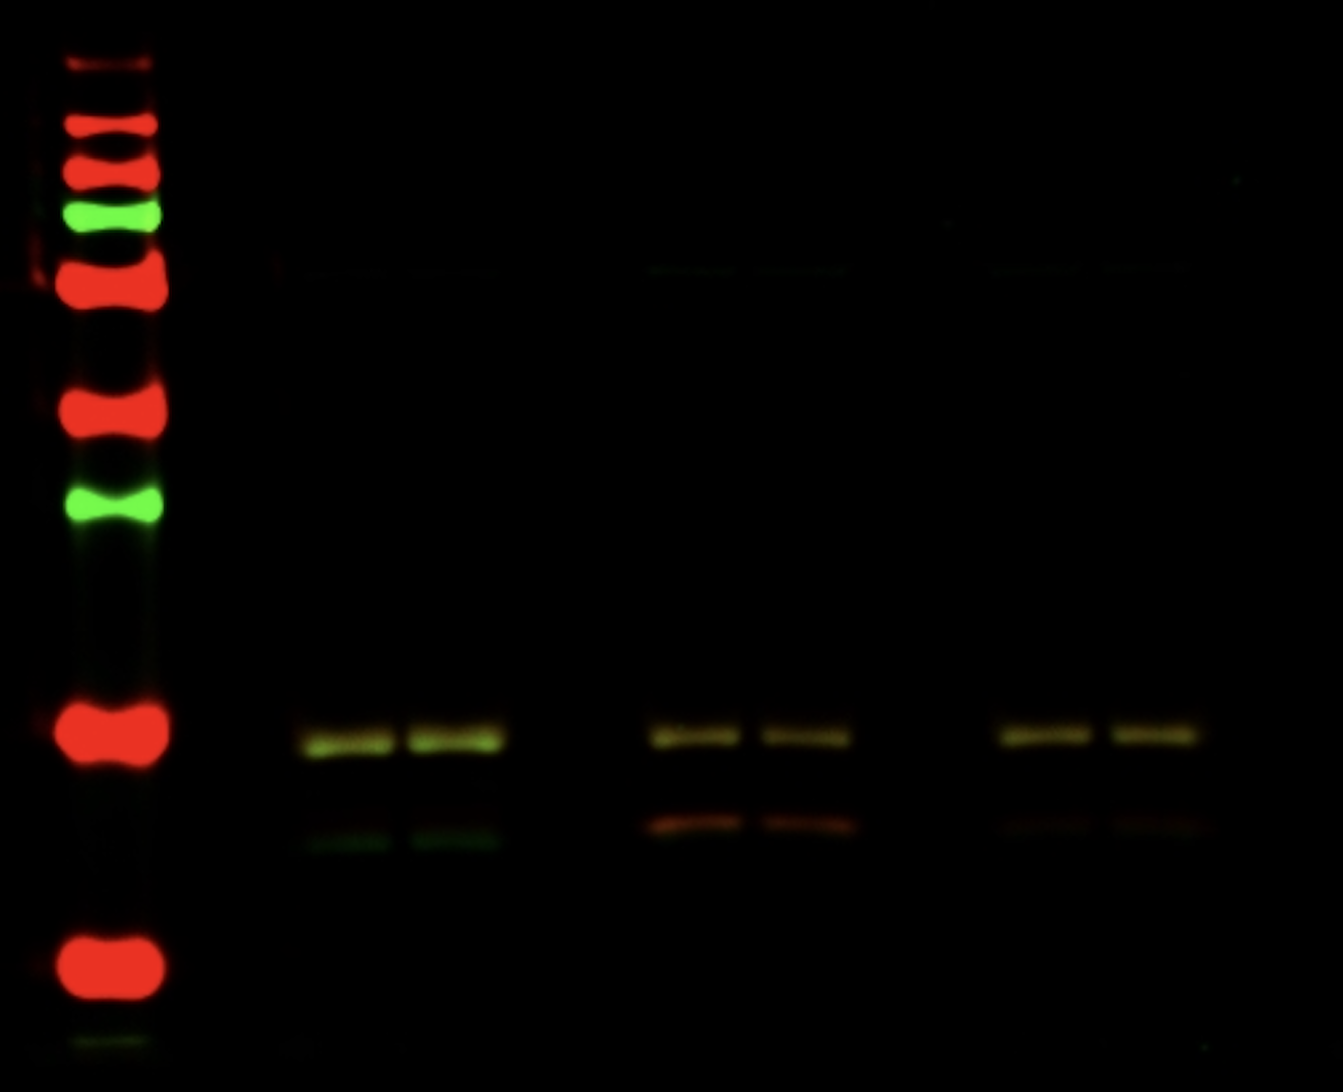
Techniques that I’ve learned!
2) Western Blotting: a technique used to detect specific proteins in a sample.
First, we separate the proteins by size using a gel, then use fluorescent antibodies to show us whether the protein we’re looking for is there and how much of it is present.
I have used this technique to measure expression of various histone modifications – such as Histone 4 acetylation!

Slide 17
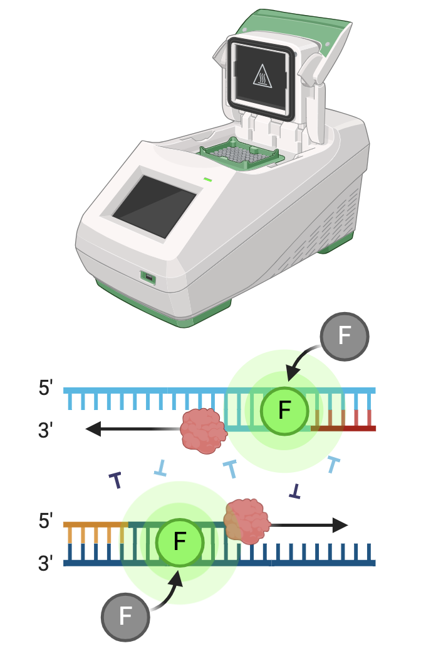
Techniques that I’ve learned!
3) Quantitative Polymerase Chain Reaction (qPCR): a technique used to measure how much a specific gene is being expressed.
We use a machine to copy that DNA and measure how much is made in real time — the more copies we see, the more the gene is being expressed!
I have used this technique to investigate genes involved with hormones and metabolism following TPhP exposure

Slide 18
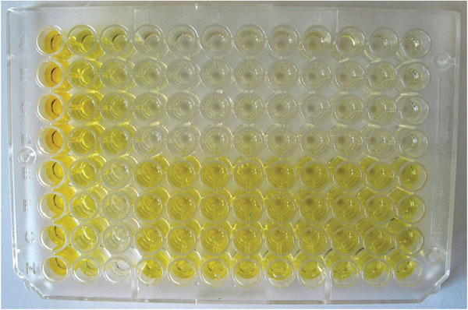
Techniques that I’ve learned!
4) Enzyme-Linked Immunosorbent Assays (ELISA): a used to measure how much of a specific molecule, like a hormone, is in a sample.
It works by using antibodies that stick to the hormone, and a color change tells us how much of it is there — the stronger the color, the more hormone is present.
I used this technique to detect molecular signals such as DNA methylation, estrogen and glycolysis levels.

Slide 19
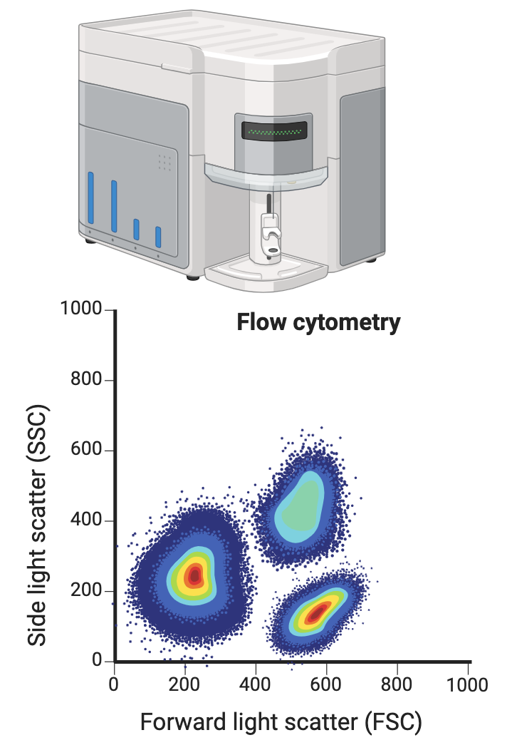
Techniques that I’ve learned!
5) Flow Cytometry: a technique that lets us measure and analyze individual cells as they flow in a stream of liquid, one by one, past a laser.
It can quickly tell us about specific markers or proteins we're interested in by detecting fluorescent tags.
I use flow cytometry to assess protein expression of various enzymes involved with estrogen, metabolic and epigenetic processes.

Slide 20
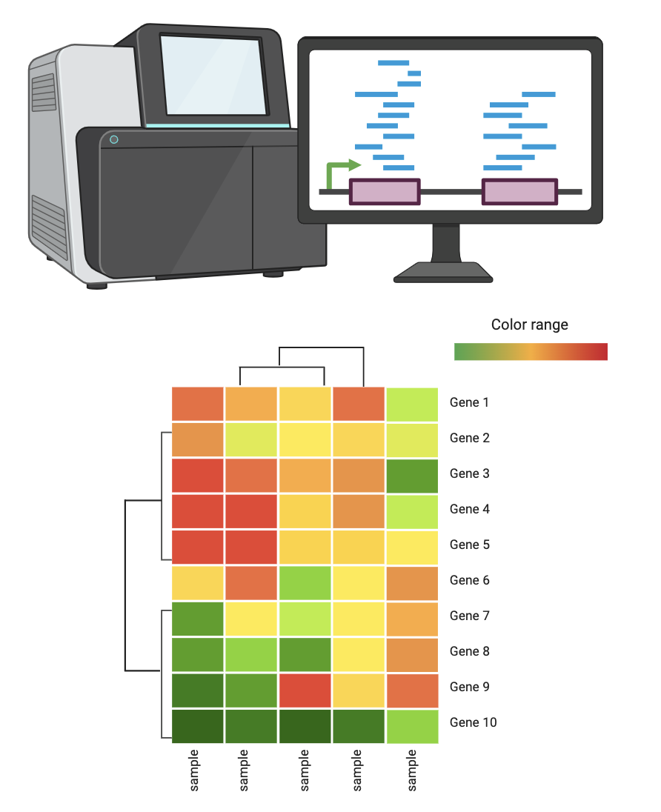
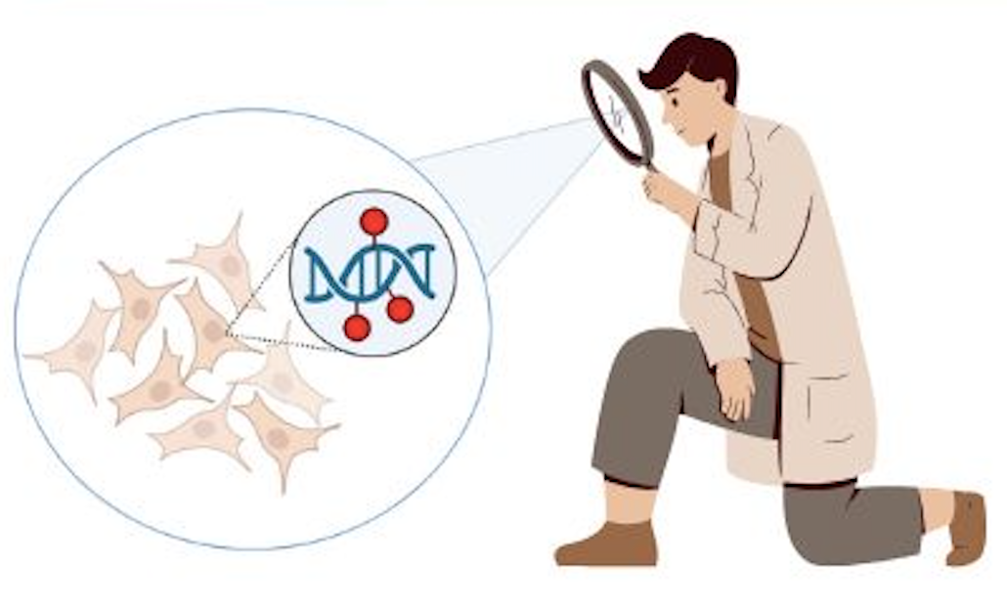
Techniques that I’ve learned!
6) RNA Sequencing: tells us about whole genome gene expression by sequencing all mRNA transcripts.
Goal: identify differentially expressed genes in embryonic cells following TPhP exposure.

Slide 21
Techniques that I’ve learned!
7) Whole Genome Bisulfite Sequencing: tells us about sites of DNA methylation across the entire genome.
Goal: identify differentially methylation regions in embryonic cells following TPhP exposure.

Slide 22
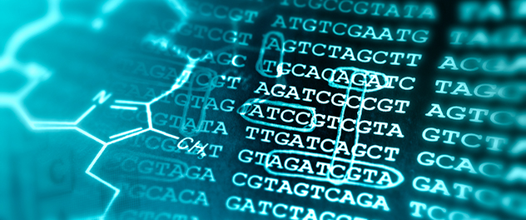
Bioinformatics Tools
Using code to analyze the massive data sets from RNA sequencing and Whole Genome Bisulfite Sequencing to determine:
Differentially Expressed Genes – are genes associated with hormones or metabolism being altered by TPhP?

Slide 23
Bioinformatics Tools
Using code to analyze the massive data sets from RNA sequencing and Whole Genome Bisulfite Sequencing to determine:
Differentially Expressed Genes – is expression of hormone or metabolism-related genes being altered by TPhP?
Differentially Methylated Regions – is DNA methylation of hormone or metabolism-related genes being altered by TPhP?

Slide 24
Notes:
My research question: Does embryonic TPhP exposure change gene regulation and health outcomes through epigenetics?
I look at how exposure to an everyday chemical during early development may change these epigenetic marks and possibly affect metabolism, hormones, or disease risk later in life.

Slide 25



ACKNOWLEDGEMENTS
Supervisor and Committee Members:
Dr. Louise Winn
Dr. Christopher Nicol
Dr. Maria Aristizabal
Winn Lab Members:
Lihua Xue
Lauren Brown
Megan Cull
Katryna Seabrook
Perri Grant
Delaine Pereira
Notes:
Thanks!

